Slide 1
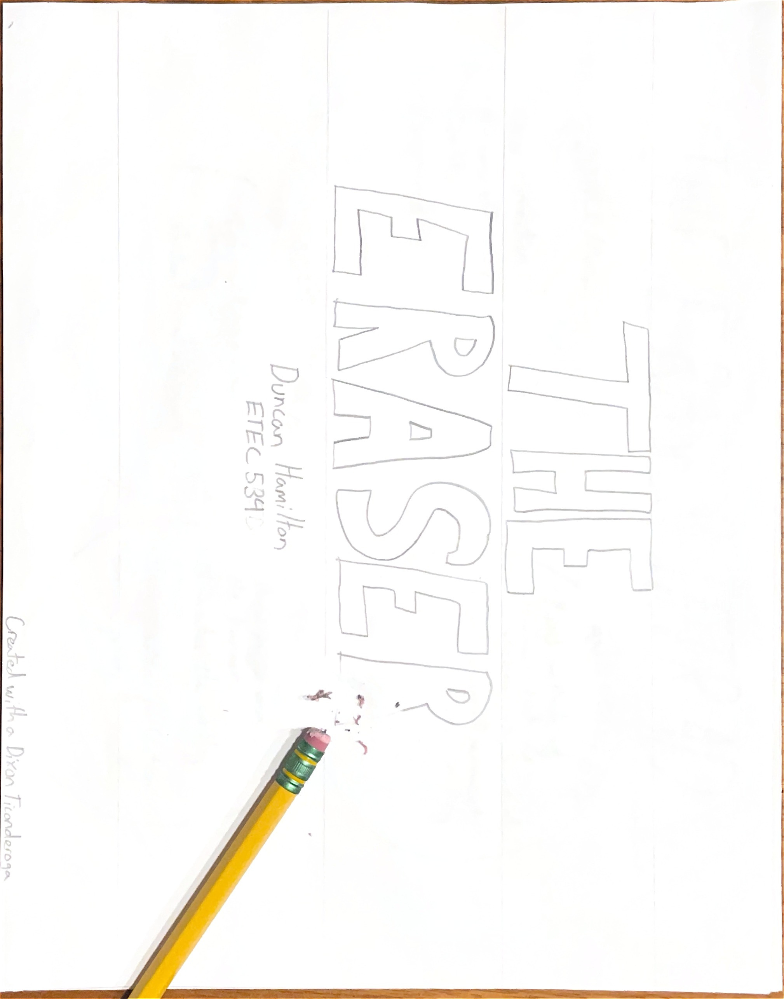
Notes:
Every mode of written word has had a method for correction. Clay tablets were smoothed over, papyrus errors were washed away with water, parchment errors covered over with gold (Keene, 2014). The invention of the graphite pencil in the 1500's necessitated a new method of correction. Methods such as rubbing paper with pumice or even bread, were commonplace (Petroski, 1989). It wasn't until the 18th century that our now familiar object sprang into use. Inventor Edward Nairne discovered rubber to be an effective remover of pencil lead from paper and is noted as the first to transform it into a marketable product (Ward, 2014). But raw rubber itself is brittle, can go bad, and crumbles over time. What transformed the tough rubber eraser into the soft and springy one we know today was Charles Goodyear’s discovery of the chemical process to vulcanize rubber in 1844 (Ward, 2014). This process cures the rubber, giving it the tight, durable, characteristics that so vastly enhance the eraser's utility.
When we think of the eraser, many will picture a rectangular piece of rubber, often embossed with company branding. Others will see the pink nub at the end of the pencil. Surprisingly, this distinction may have a regional influence. In Europe, the eraser is generally a distinct object, sold next to a pencil devoid of the familiar pink nub. Whereas in North America, it’s rare to see a pencil without an incorporated pencil at its opposite tip (Ward, 2014). The discrepancy is likely a combination of economics related to manufacturing, and simple preference (Petroski, 1989).
Joseph Reckendorfer and the company Eberhard Faber both claimed to have invented the concept of the combined pencil eraser, escalating their battle all the way to the way to the Supreme Court. Both patents were ultimately declared invalid, for reasons LaTour would appreciate, citing “A combination, to be patentable, must produce a different force, effect, or result in the combined forces or processes from that given by their separate parts. There must be a new result produced by their union; otherwise it is only an aggregation of separate elements.” To the Supreme Court, the pencil and eraser, even when combined, are two distinct actors.
The eraser's induction as a learning tool would likely have roughly coincided with the widespread use of pencil and paper over slates. Though pencil, paper, and eraser were available and surely appeared in schools for tracing and line preparation, it wasn't until the late 1800s that mass manufacturing made them a cheap and abundant choice for classroom use (Petroski, 1989). Compulsory education in the United States also solidified eraser as requisite classroom technologies, coinciding with Faber’s introduction of the “pink pearl” eraser, which to this day represents the quintessential eraser form (Ward, 2014).

Slide 2
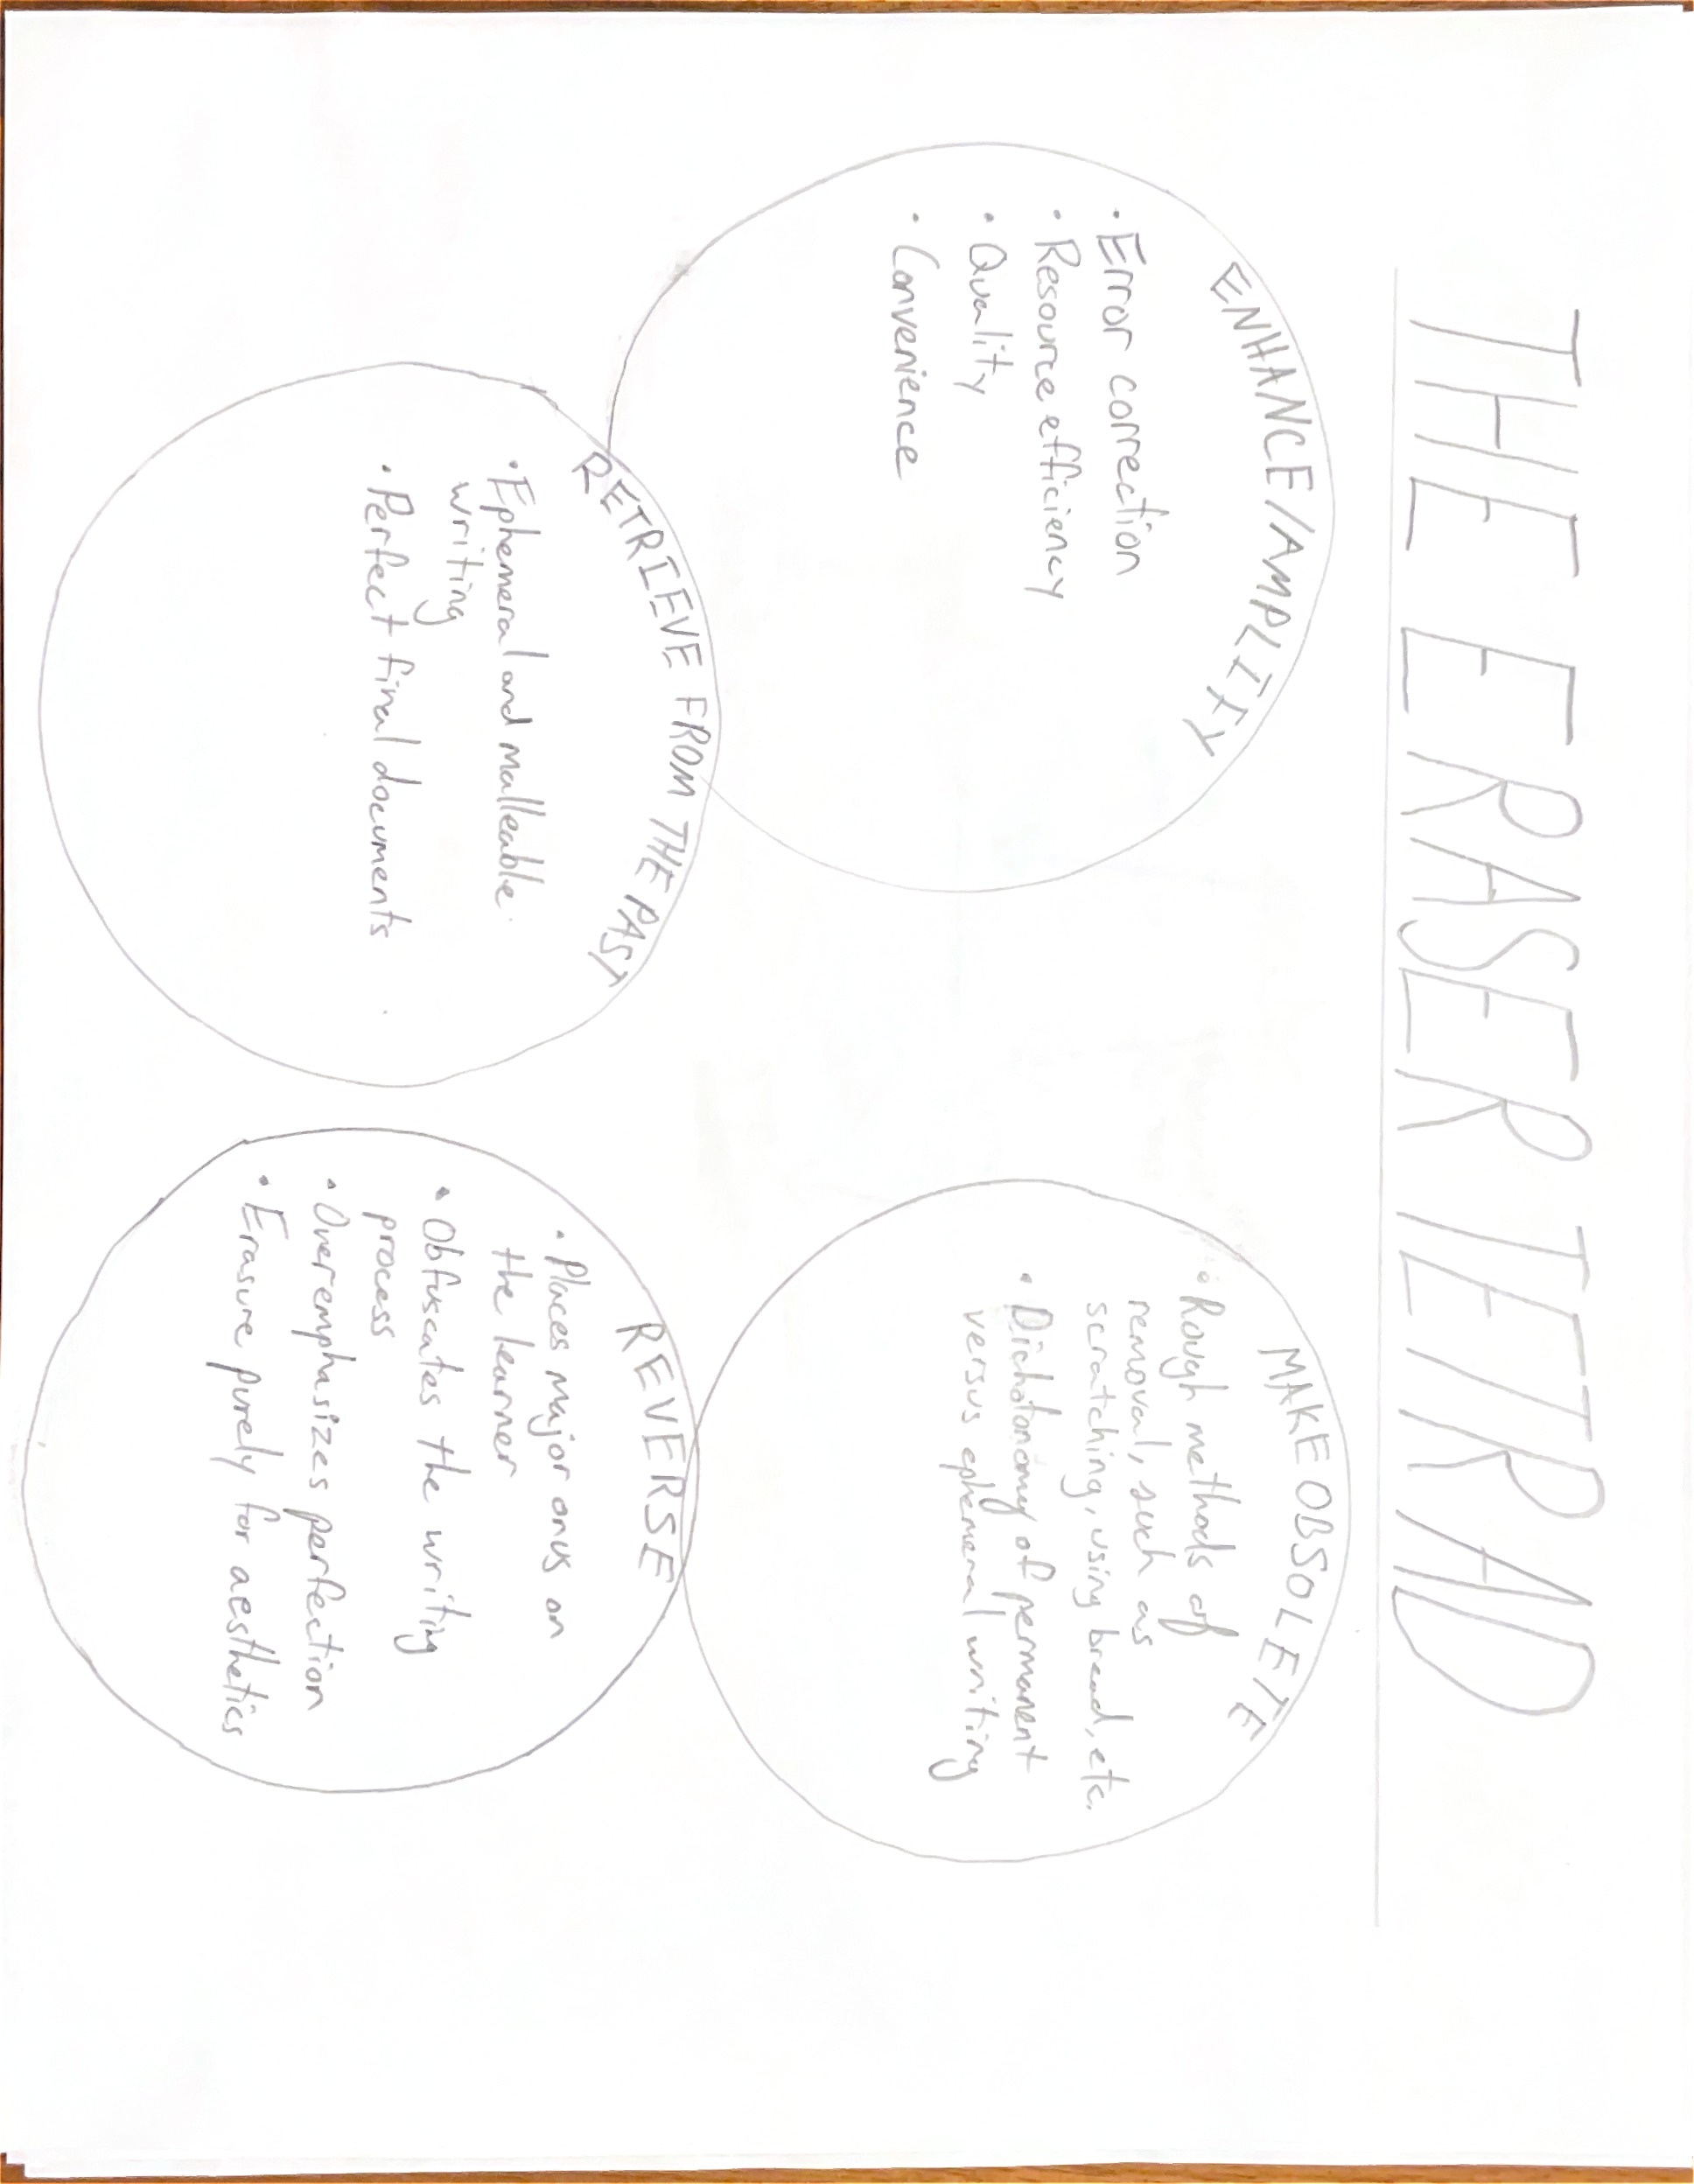
Notes:
Like many seemingly benign objects, the eraser maps to McLuhan’s tetrad in surprising ways (Library and Archives Canada, n.d.)
What does it enhance/amplify?
The eraser enhances the learner’s ability to correct errors. No longer does an error sully a page, create a messy presentation, or require starting over. The ability to remove pencil marks enhances the final aesthetic presentation of written work.
What does it retrieve from the past?
From the past, the eraser brings the ephemeral and malleable methods of writing. Writing tools such as the slate or the wax tablet were inherently temporary, and through their simple erasure processes, provided space not for permanent recording, but fleeting marks and experimentation (Petroski, 1989). In contrast, the eraser also retrieves the appreciation for aesthetic presentation of writing. The ability to avoid unsightly scratches and strikethroughs means that a high-quality written work can be produced without worrying about errors.
What does it make obsolete?
Historical methods of writing correction were complex, rough, expensive, or tedious (Keene, 2014; Tancia Ltd., 2016). Yes, erasure leaves marks and detritus on the page, but these imperfections can be managed. One no longer needs to rub stale bread on a page. The eraser, in many ways, removes the dichotomy between temporary and permanent writing. It effectively renders obsolete the need to choose between an editable, adjustable canvas such as the slate, and the permanence of ink. It offers something in-between.
What does it reverse into when pushed to extremes?
The eraser empowers the learner to correct errors, but does it also overemphasize this onus? The ability to instantly correct any perceived error may cause the write to fixate on error detection. Text without errors is often ideal, but in the learning environment, the ability for teachers to trace the learning process through the evidence of errors could benefit instruction. Instead, the eraser blackboxes the writing process, fixating on the final result. Lastly the erasers intended use as correction and removal can be pushed to one of creation, as evidenced by the art techniques that leverage its erasure to create new elements (Pindyck, 2018).

Slide 3
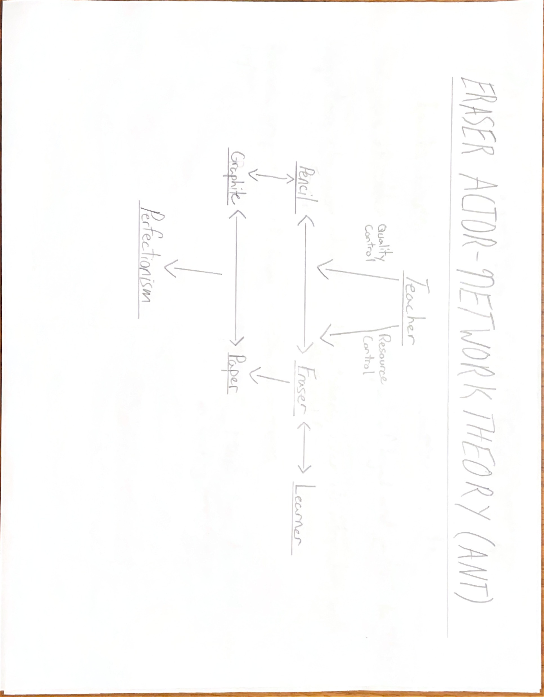
Notes:
Without the eraser writing, is either permanent or ephemeral. Permanent - not in the sense that it cannot be removed, but this removal leaves unsightly and distracting evidence, at least when done without substantial effort. Try scratching some ink off paper with any sort of sharp implement and you'll see for yourself. When God himself chiseled out the 10 commandments, how would he have corrected any errors? The scribes of medieval Europe recorded many errors that have survived centuries, forced to scratch out, strike-through, or creatively adapt their mistakes for all to see (Rauer, 2012; Keene, 2014).
Ephemeral - in the way that the classic schoolroom writing slate could be wiped clean (Davies, 2005). Errors or mistakes were simply wiped away, the slate a vehicle for the briefest of recording. Certainly, the temporary nature of the slate makes it a great tool for practice, but as a tool for recording or documentation it is useless.
The eraser's symbiosis with the pencil thus positions it somewhere in-between. The pencil creates a record through the marks of its graphite, one which is reasonably tolerant to external forces. But these marks can be removed, adjusted, and remade through the eraser.
The act of error correction itself has been delegated from teacher to erasers. Teachers represent the first line of quality control when reviewing writing written using permanent implements. Their notes and markup, often characterized by the all too familiar red pen, denote a required set of changes for subsequent documents produced by the learner. By substantially reducing the cost of errors, the eraser shifts this paradigm, placing the onus of initial quality control on the learner.
Resource control has been delegated from teachers to erasers. Errors in permanent writing methods may require complete abandonment of the writing canvas. The trope of the writer balling up a piece of paper in frustration and throwing it into the trashcan is emblematic of writing without an eraser. These errors are resource intensive, sometimes demanding for learners to start from scratch via resources provisioned by the teacher. The eraser removes this requirement. Starting from the beginning is no longer necessary when errors can be removed from the canvas using a ubiquitous piece of rubber.
The impact of this delegation is significant, and one that even pencil manufacturers have been aware of since the eraser's introduction (Petroski, 1989). By delegating error correction from the teacher to the eraser, the process of error correction is made inherently easier. No longer is error correction funnelled through a singular individual, but instead errors can be corrected immediately and in the moment. Does this inadvertently cause more errors to be made? Pencil manufacturers certainly thought so in their discussions on placing erasers on the end of pencils (they manufactured and sold them anyways!) (Petroski, 1989).
From the opposite perspective, this delegation is liberating. No longer is the teacher the sole locus of correction, but instead the eraser empowers the learner. The eraser transforms errors from barriers to input that one must cautiously avoid, to an easily correctable part of the writing process. But as discussed in the tetrad, this delegation also serves to 'blackbox' the writing process. Whereas the strike-throughs and margin notes of a pen provide an indelible reflection of writing activity, the eraser can remove all sins. In this sense, the delegation from teacher to eraser involves sacrifice.
Our social relations demand perfection. The learner's written output is scrutinized, not only by its content, but also, both consciously and unconsciously, by its presentation. An early use for the graphite pencil in the classroom was for creating trace-lines to guide proper penmanship (Petroski, 1989). The eraser prescribes back to us this perfectionism, compelling the creation of documents which, at the very least, appear error-free.

Slide 4
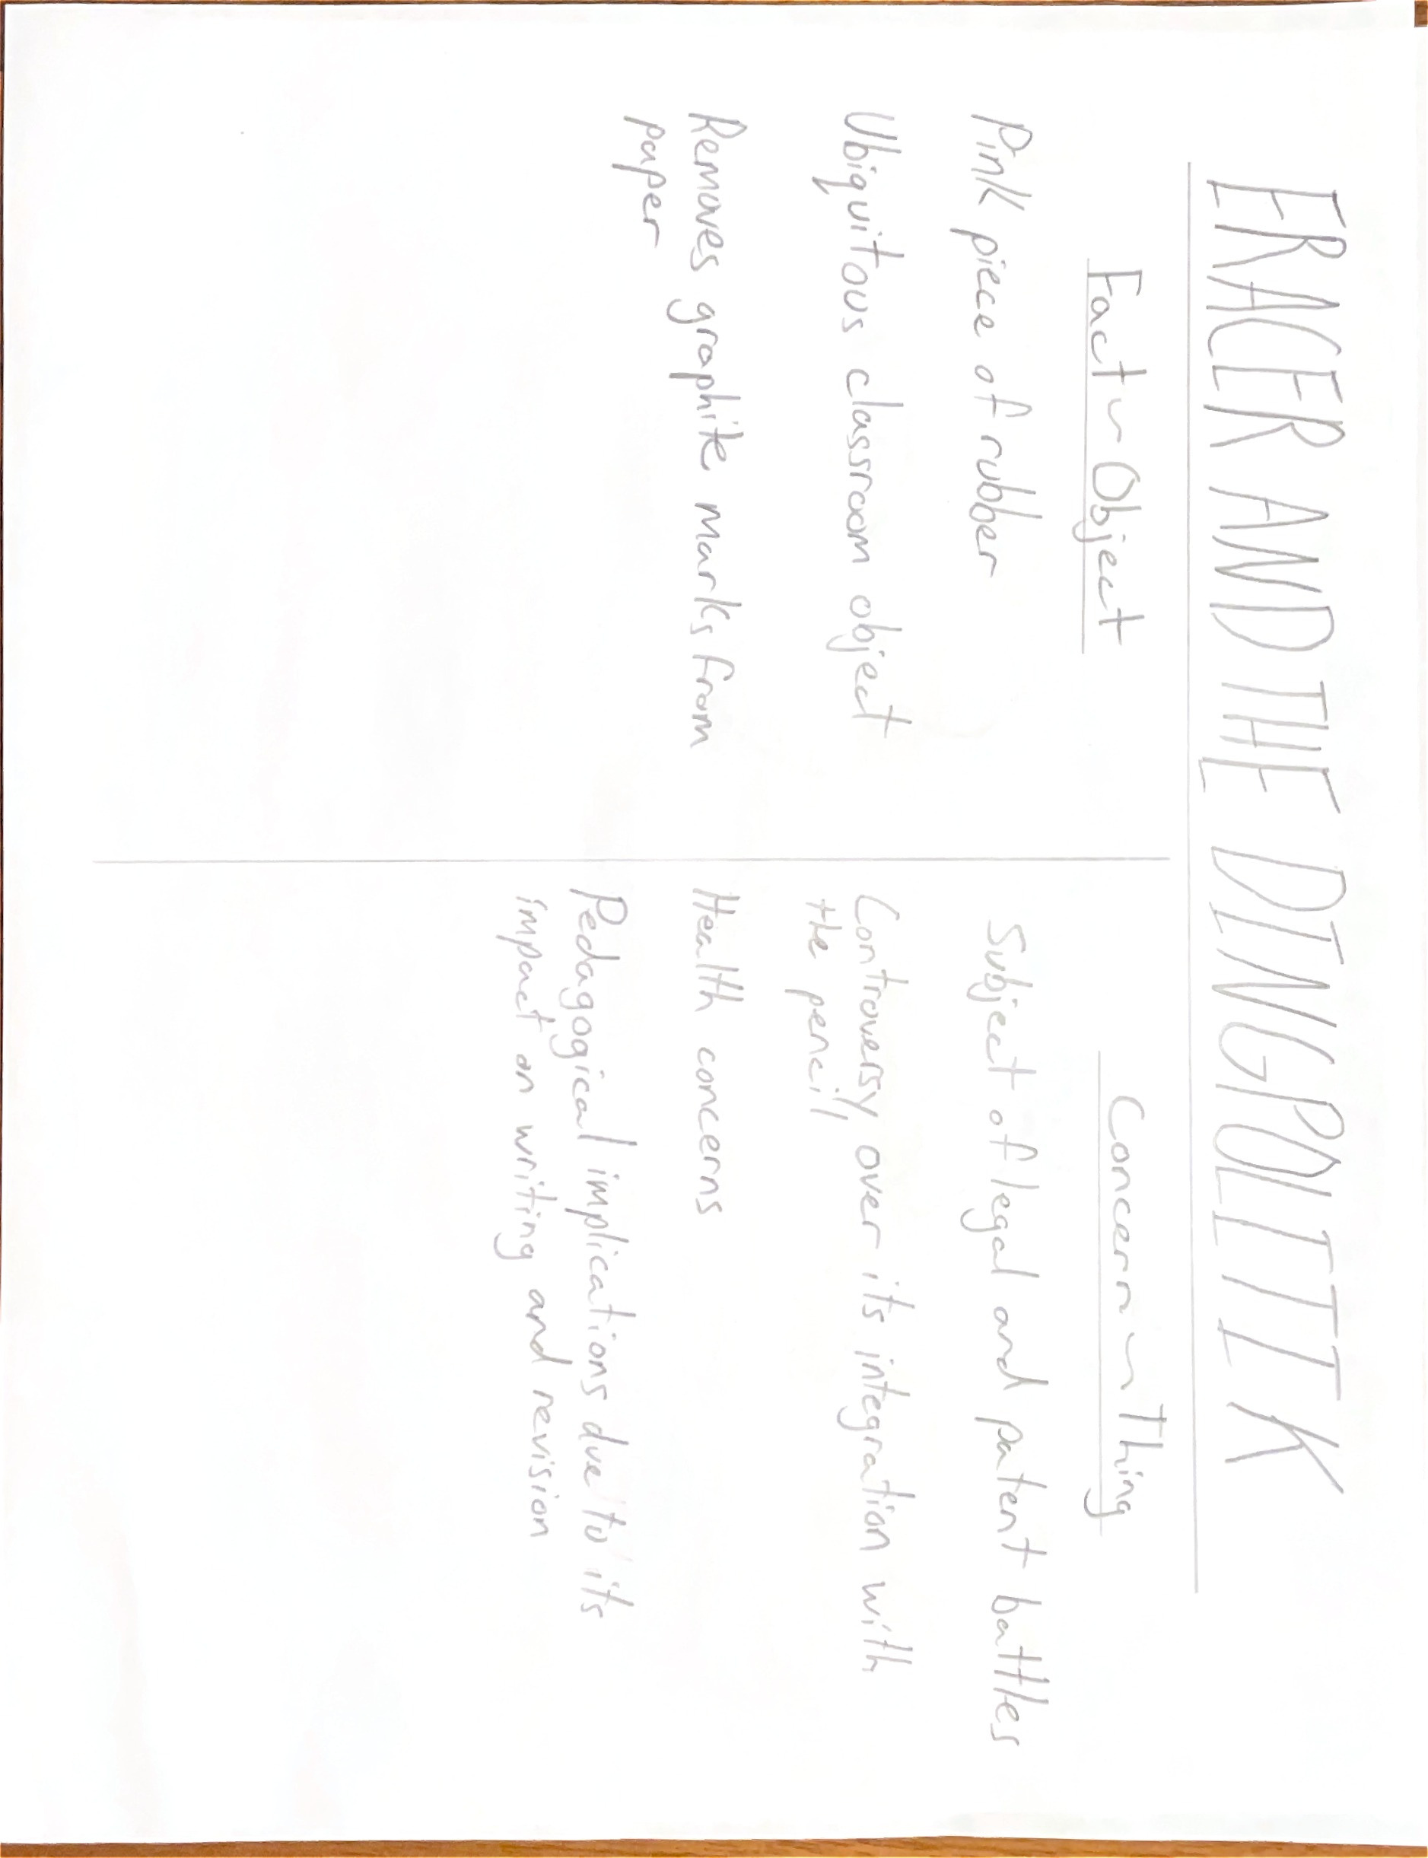
Notes:
On the surface, the eraser is a benign object. Pink, inoffensive, unassuming. A glorified piece of rubber effective at rubbing graphite off of paper, this is a matter of fact. But this does the eraser a disservice, as the complex pedagogical implications associated with it make it a significant point of discussion with long-lasting cultural staying power. It is clearly, as defined by Latour, a thing (Latour, 2004).
The eraser has been subject to multiple legal battles over patents, some escalating all the way to the United States supreme court. (Miller, 1952) As early as 1903, manufacturers derided the fusion of pencil with eraser for classroom use, boldly claiming that making it easier for learners to correct errors leads to more errors being made (Petroski, 1989). Health related fears associated with erasers were abound, primarily due to learner's propensity to stick them in their mouths (Petroski, 1989). The delegation of error correction to the eraser has been one of tangential inquiry due to the shifts in revision it enables, as evidenced by work of literacy pioneer Donald Graves (Graves, 1982). These are evidently matters of concern.
The surprising breadth of contentions around the simple eraser position it as an undeniable 'thing'.

Slide 5
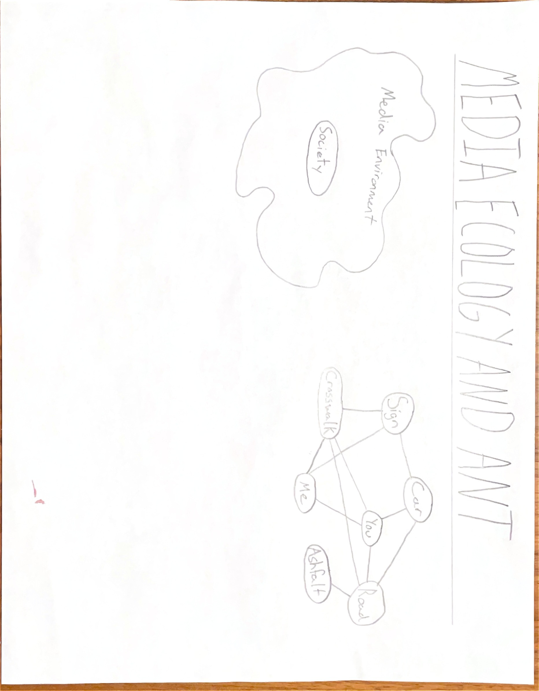
Notes:
Much like biologists survey the broad ecosystem but also analyze the individual symbioses between its composing parts, so too do media ecology and ANT relate. If media ecology describes how society adapts to and is extended by technology, then actor-network theory describes the granular dynamics of this adaptation. In this way, they are complementary, yet they also fundamentally diverge. Media ecology emphasizes the environment, with humanity positioned as a constant on the plane of an ever-shifting technological ecosystem (Strate & Lum, 2000; Holland 2017). The environment is technological, physical, tactile, semiotic, and society is perpetually adjusting with it. ANT does not share this emphasis, eschewing the environment for the individual actors, whether they be human or non-human. To ANT, the individual connections between actors is more important and more complex than the one between humanity and environment.
To media ecology, the eraser is a component of writing technology, an extension of our ability to record and correct. To ANT, the eraser is a distinct entity in a complexly inter-connected network of other actor nodes.
References
Davies, P. (2005). Writing slates and schooling. Australasian Historical Archaeology, 23, 63-69. https://www.jstor.org/stable/29544535
Graves, D. H. (1982). A Case Study Observing the Development of Primary Children’s Composing, Spelling, and Motor Behaviors during the Writing Process. Final Report, September 1, 1978-August 31, 1981. https://eric.ed.gov/?id=ED218653
Holland, T. (2017). Fielding (un)stable object relations: Actor-network theory or media ecology? Medium. https://travisaholland.medium.com/fielding-un-stable-object-relations-actor-network-theory-or-media-ecology-f2f362d5dc6d
Keene, B. C. (2014). Medieval Copyediting [Education]. Medieval Copyediting. https://blogs.getty.edu/iris/medieval-copyediting/
Latour, B. (2005). From realpolitik to dingpolitik: An introduction to making things public. In B. Latour & P. Weibel (Eds.), Making things public: Atmospheres of democracy (pp. 14-41). MIT Press.
Latour, B. (1992). Where are the missing masses? The sociology of a few mundane artifacts. In W. E. Bijker & J. Law (Eds.), Shaping technology/building society: Studies in sociotechnical change (pp. 225-258). MIT Press.
Library and Archives Canada. (n.d.). Old messengers, new media: The legacy of Innis and McLuhan - McLuhan tetrad. Collections Canada.
https://web.archive.org/web/20180420175433/http://collectionscanada.gc.ca/innis-mcluhan/030003-2030-e.html (Original work archived April 20, 2018)
Miller, L. G. (1952). Pencils and Erasers. Journal of the Patent Office Society, 34(11), 839–846.
Petroski, H. (1989). The pencil: A history of design and circumstance. Alfred A. Knopf.
Pindyck, M. (2018). Frottage as inquiry. International Journal of Education through Art, 14(1), 13–25. https://doi.org/10.1386/eta.14.1.13_1
Rauer, C. (2013). Errors and Textual Problems in the Old English Martyrology. Neophilologus, 97(1), 147–164. https://doi.org/10.1007/s11061-012-9301-9
Strate, L., & Lum, C. M. K. (2000). Lewis Mumford and the ecology of technics. New Jersey Journal of Communication, 8(1), 56–78. https://doi.org/10.1080/15456870009367379
Tancia Ltd. (2016). Now you see me, now you don't: A history of erasure. https://www.pens.co.uk/pen2paper/wp-content/uploads/2016/01/Now-You-See-Me.pdf
Ward, J. (2014). The perfection of the paper clip: Curious tales of invention, accidental genius, and stationery obsession. Touchstone.

